Slide 1
SQL WORK SAMPLES
This presentation contains screenshots of SQL DDL & DML statements in Microsoft SQL Server Management Studio

Slide 2
CREATe & POPULATE tables
Here are screenshots of SQL DDL statements in Microsoft SQL Server Management Studio to create several tables, indicating the primary and foreign keys, constraints, and attribute characteristics and then insert data into those tables

Slide 3
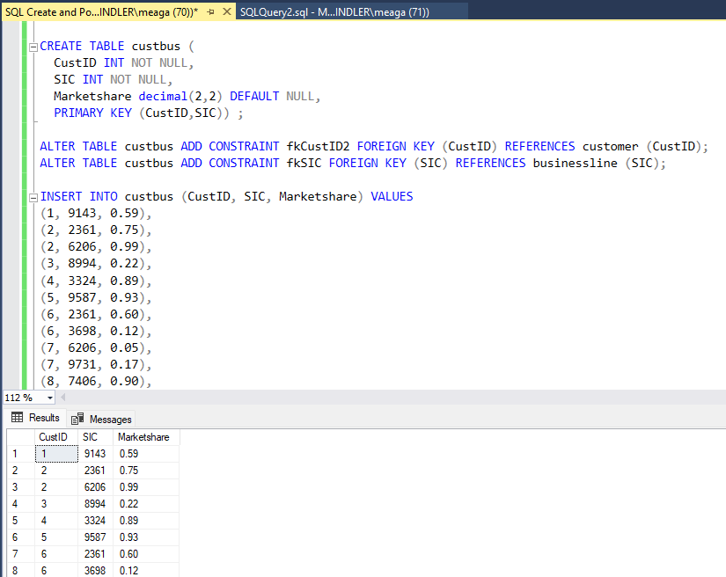
--I created the table custbus, used alter statements to add foreign key constraints, inserted values into the table (using Excel to create the syntax). The first 8 rows of output of the table show in the results window.

Slide 4
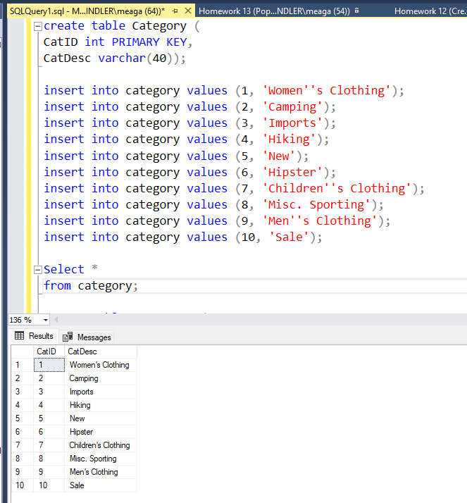
--I created the category table, indicated the primary key, inserted values into the table (using Excel to create the syntax). The output of the category table is shown in the results window.

Slide 5
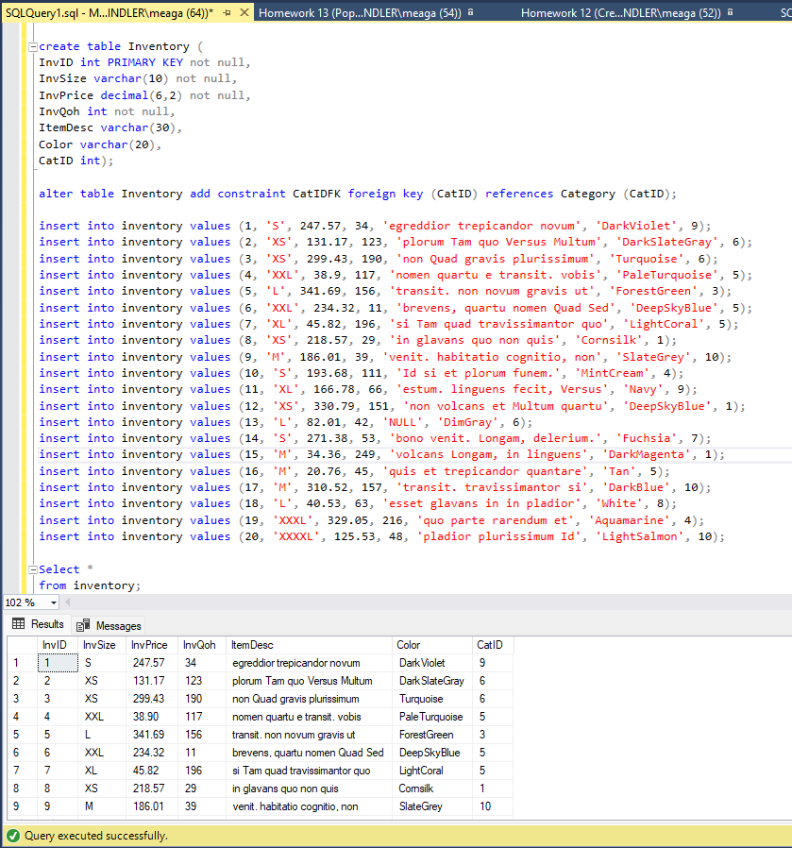
--I created the inventory table, which is a child to the category table. It includes a foreign key constraint from the category table. I inserted values into the table (using Excel to create the syntax). The output of the inventory table is shown in the results window.

Slide 6
SQL Joins
Here are screenshots of SQL joins and their output, which I used to create custom tables to analyze within Microstrategy

Slide 7
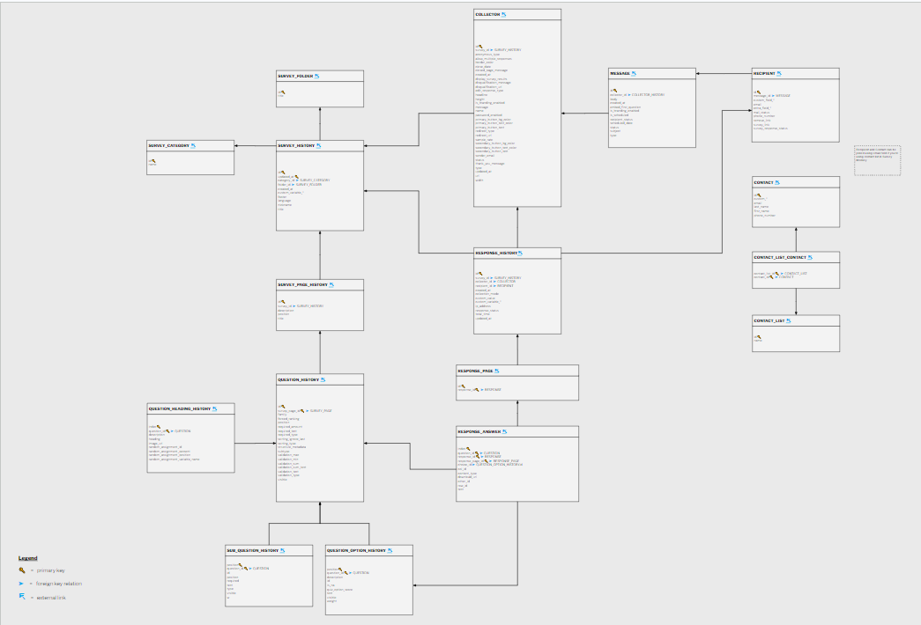
ERD
We used a fivetran to connect SurveyMonkey data source and our RDMS Snowflake
Full ERD Here

Slide 8
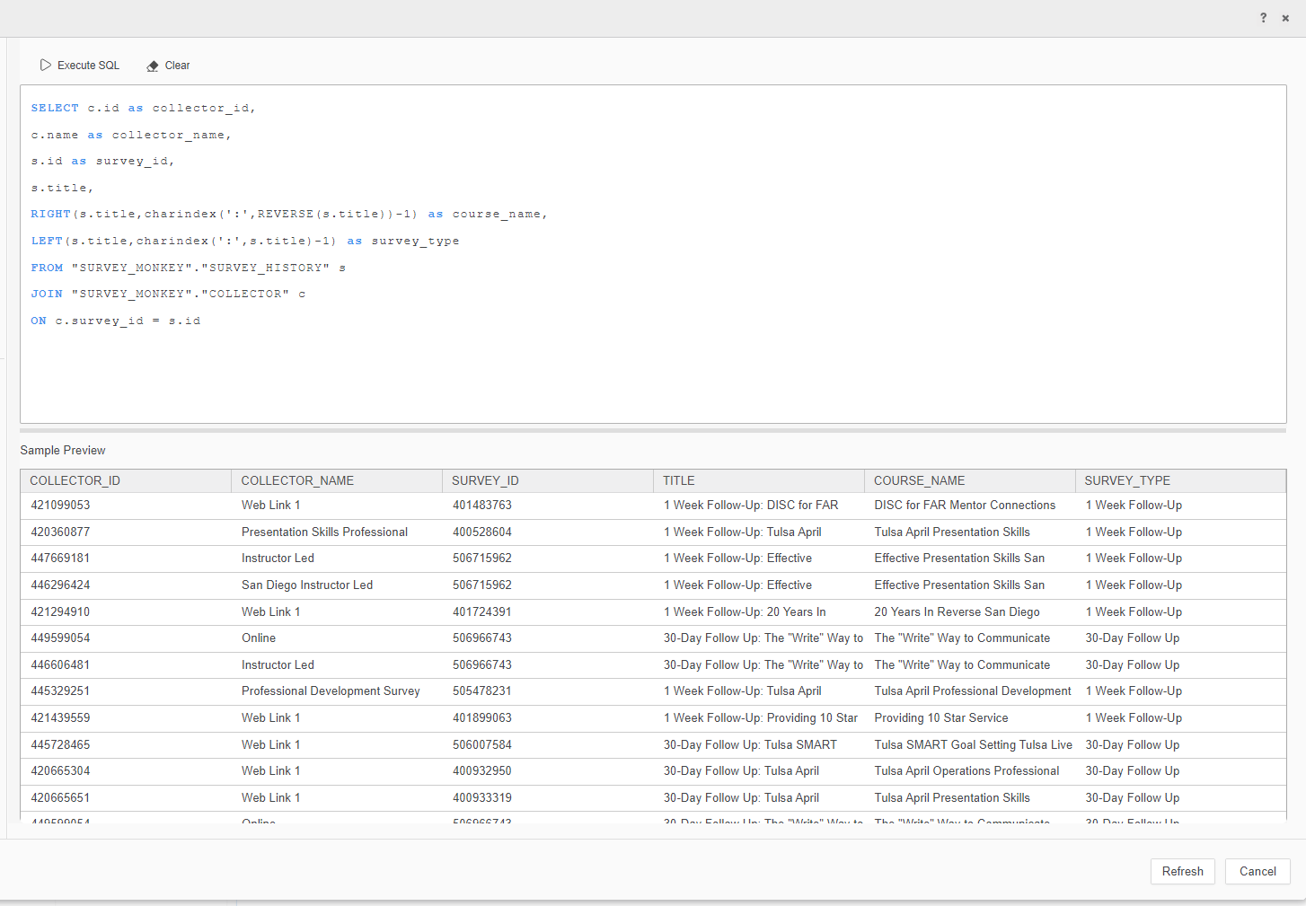
--Joining fields from survey history and collector tables from SurveyMonkey into Microstrategy; Used RIGHT and LEFT commands to split one column into two variables

Slide 9
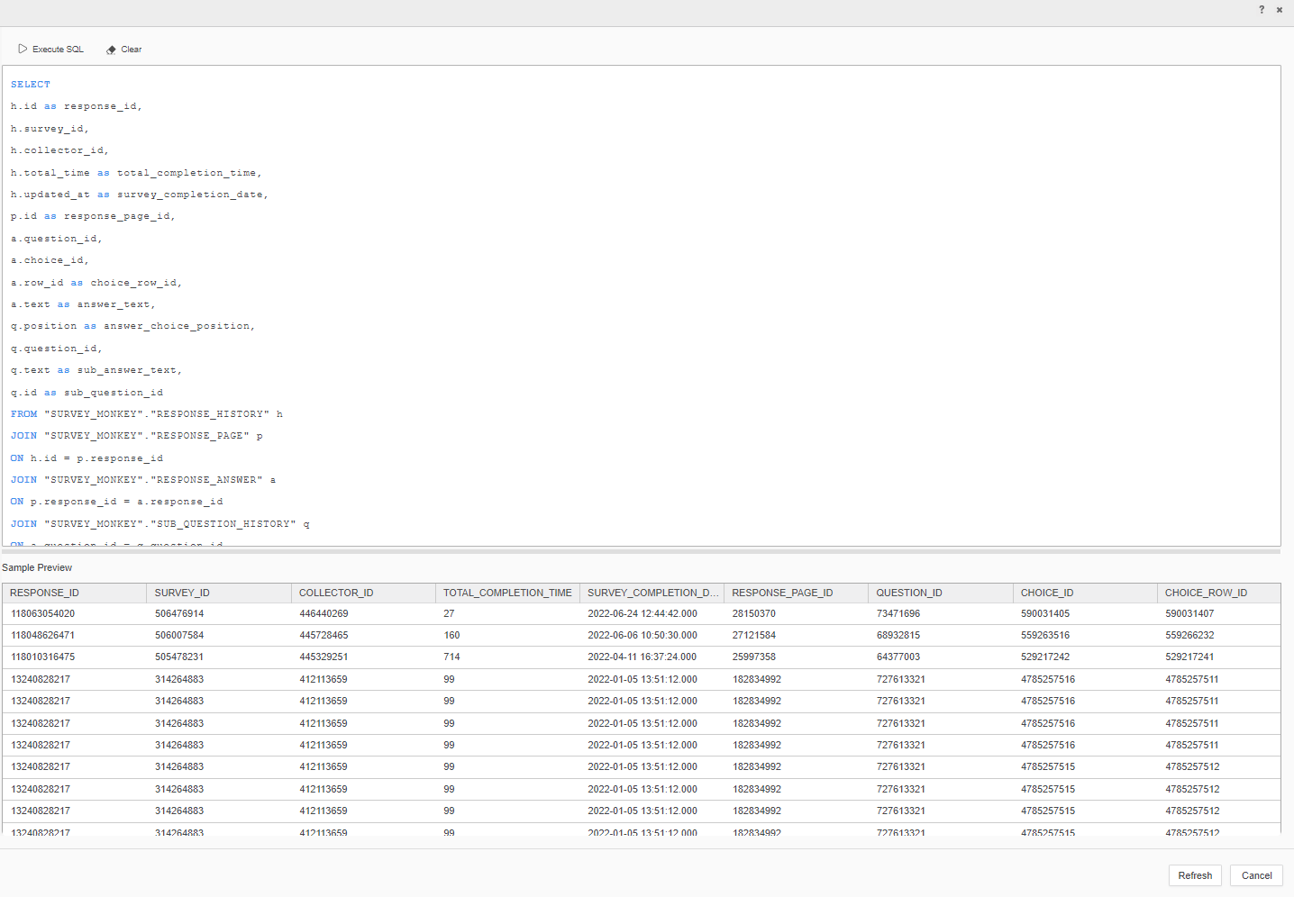
--Joining fields from 4 separate tables using SQL DML

Slide 10
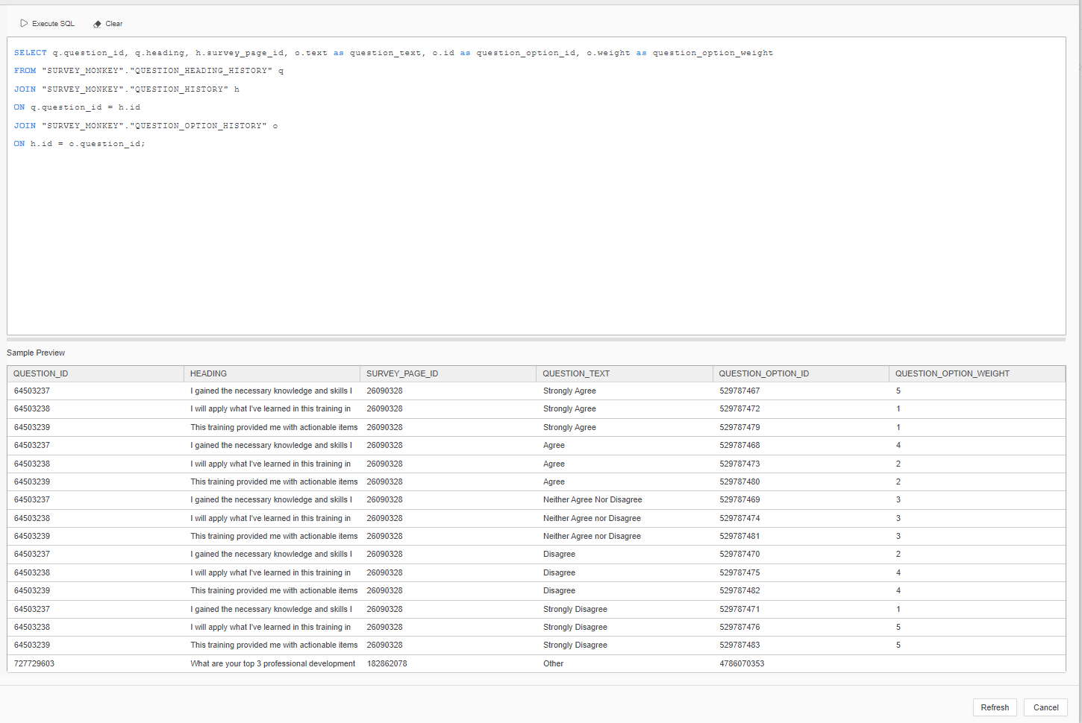
--Joining fields from three question-related tables from SurveyMonkey to utilize within Microstrategy

Slide 11
Joining tables to answer business questions
Here are screenshots of answering questions using SQL queries from multiple tables. The related SQL scripts and outcomes are shown in the slides below.

Slide 12
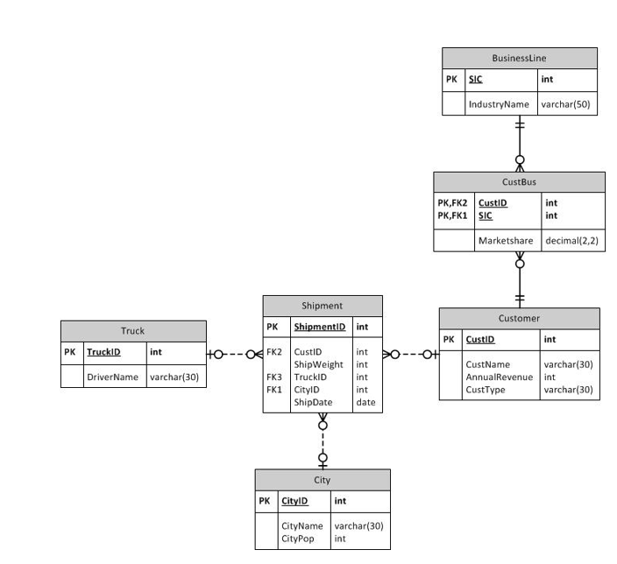
ERD
This is the ERD used to understand the relationships between the tables on the next 5 slides.

Slide 13
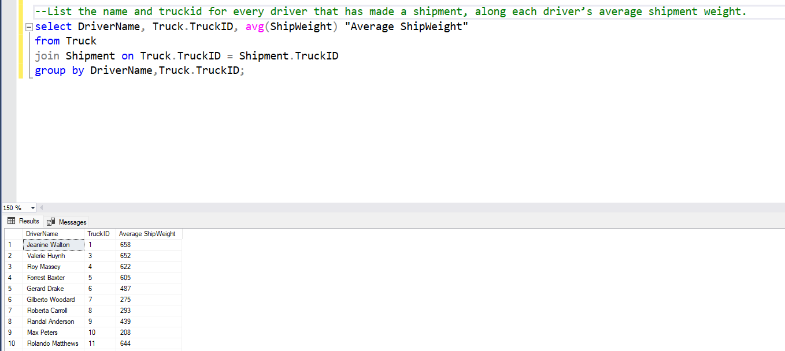

Slide 14
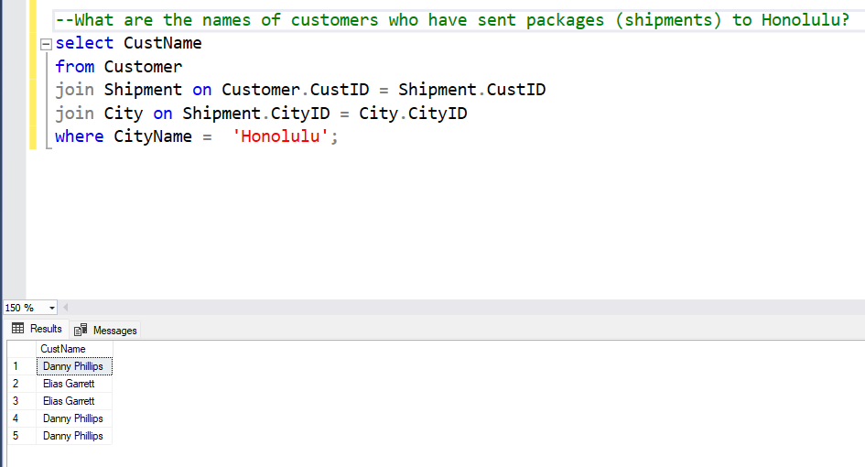

Slide 15
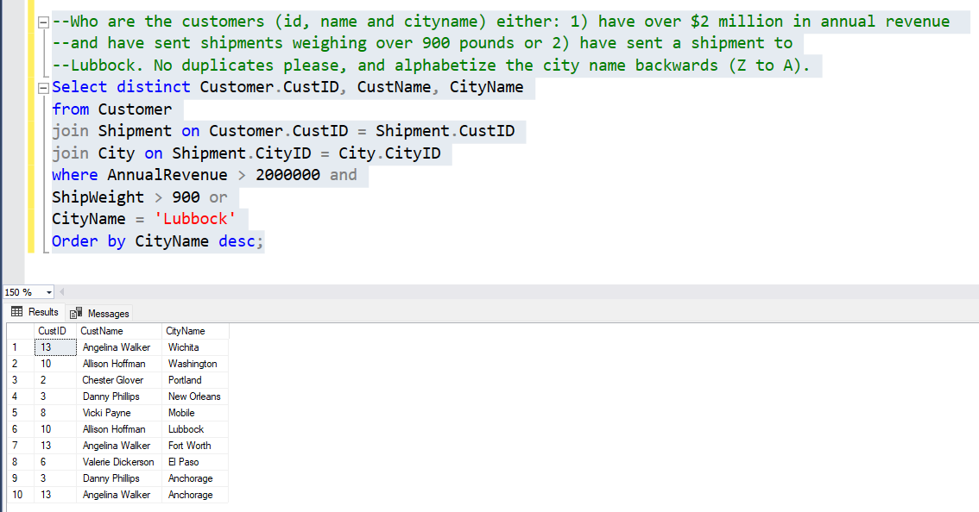

Slide 16
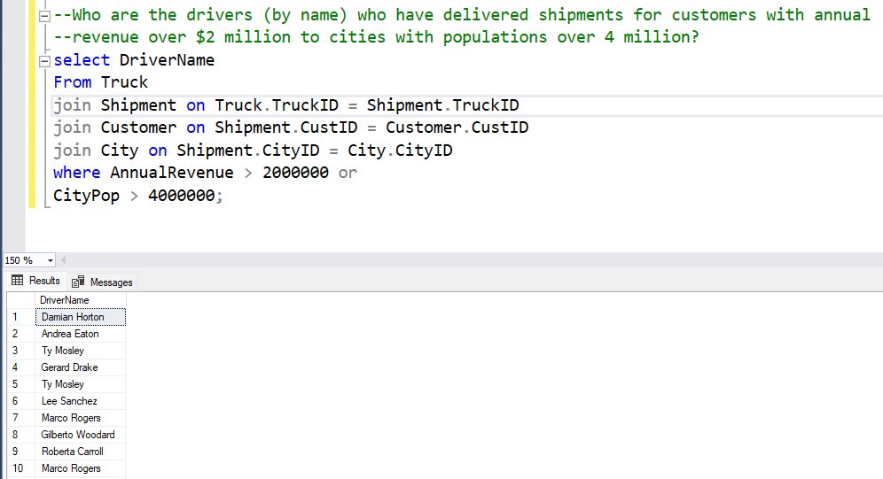

Slide 17
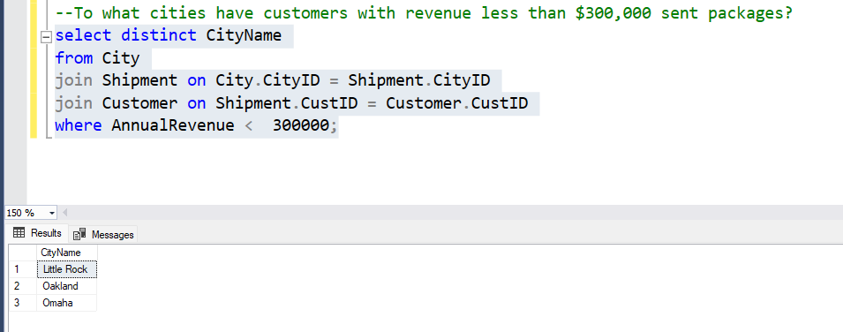

Slide 18
SQL QUERY TABLES
Here are screenshots of answering questions using SQL queries from related tables. The related SQL and text files show all of the queries.

Slide 19
ERD
This is the ERD used to understand the relationships between the tables on the next 3 slides

Slide 20
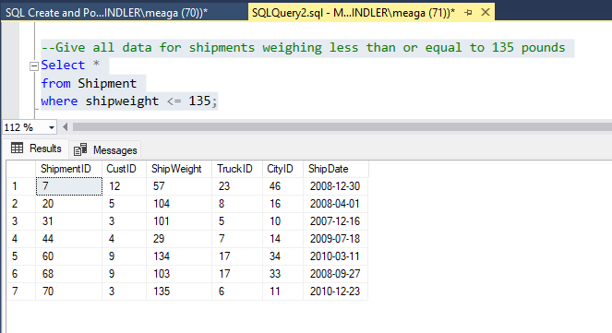

Slide 21
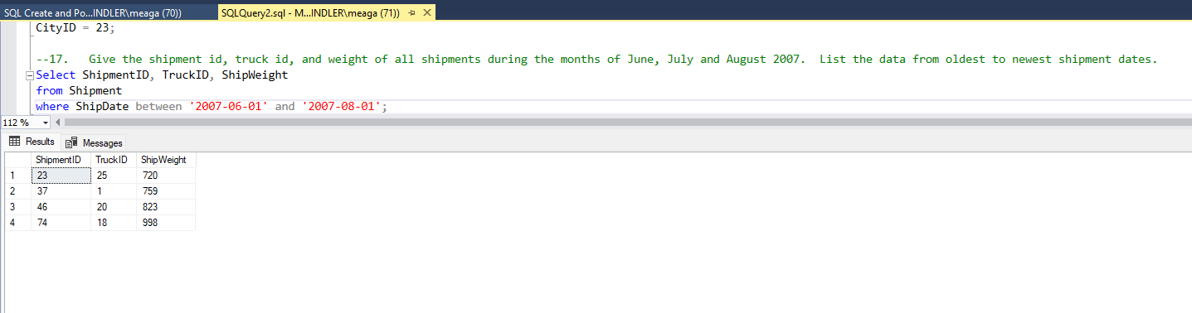

Slide 22
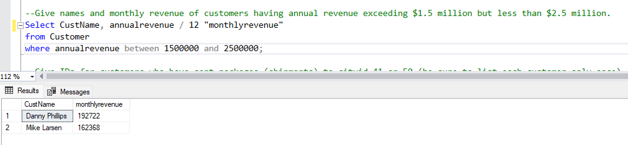

Slide 23
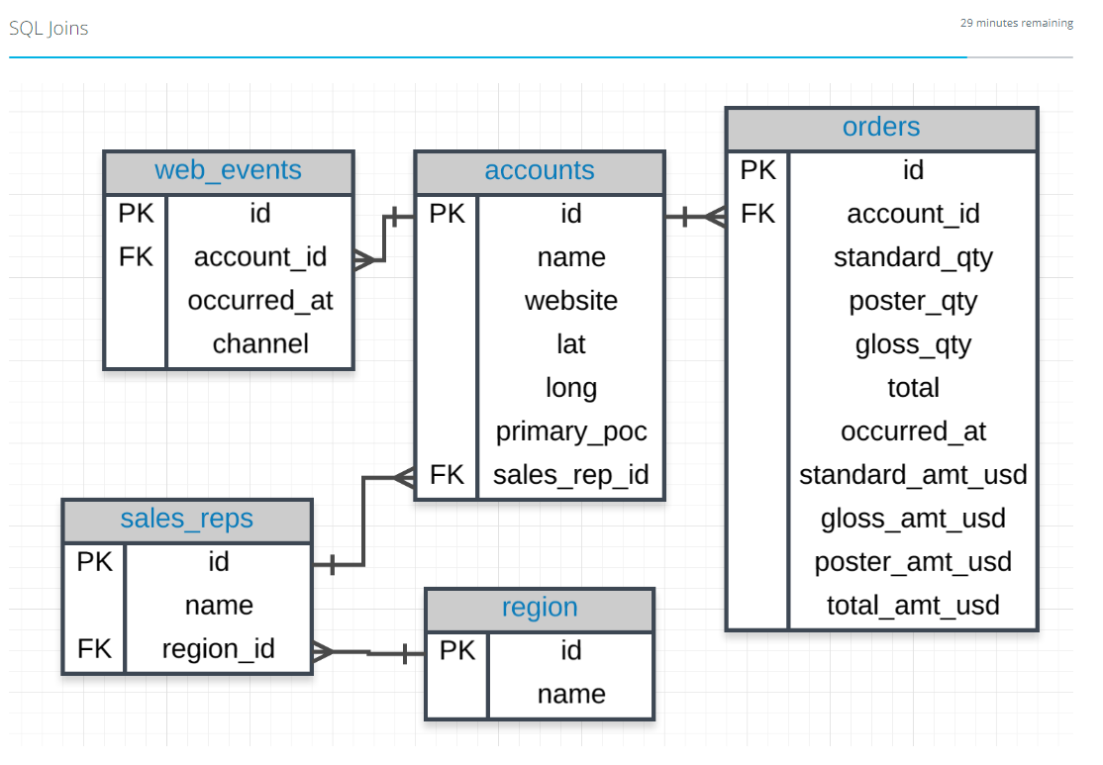
ERD
This ERD is used to understand the relationships between the tables for the next several slides

Slide 24
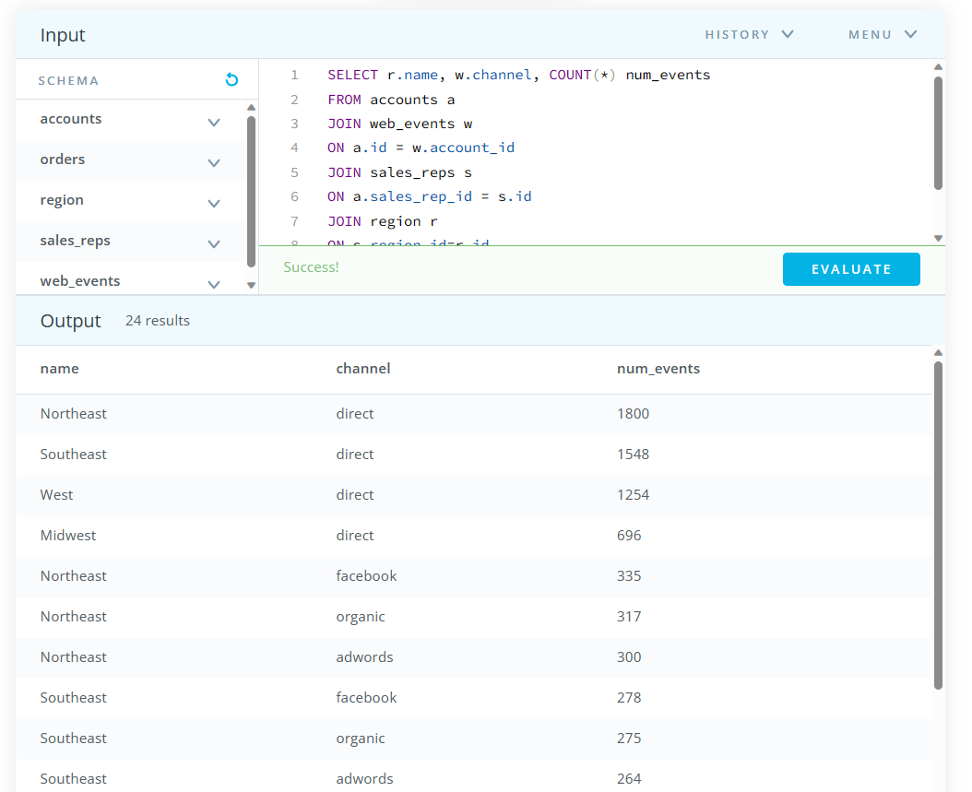
Objective : Determine the number of times a particular channel was used in the web_events table for each sales rep. Your final table should have three columns - the name of the sales rep, the channel, and the number of occurrences. Order your table with the highest number of occurrences first.

Slide 25
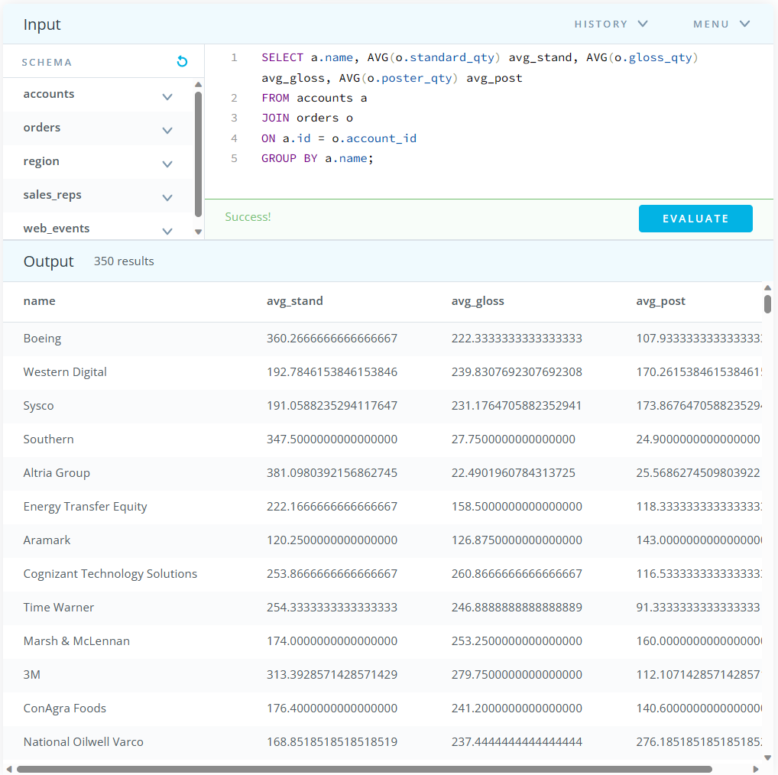
Objective : For each account, determine the average amount of each type of paper they purchased across their orders. Your result should have four columns - one for the account name and one for the average spent on each of the paper types.

Slide 26
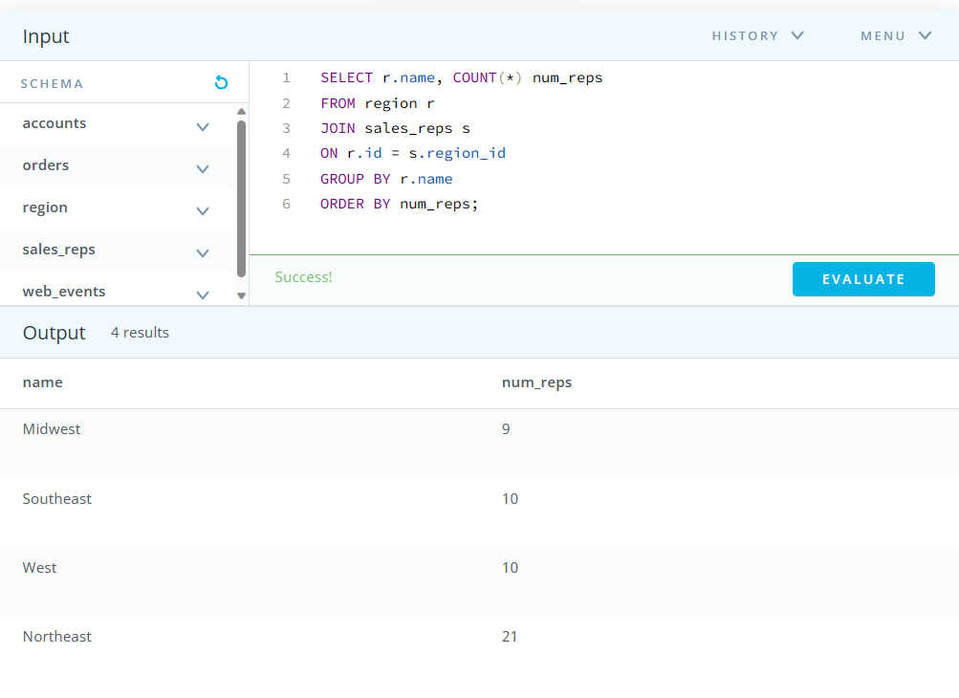
Objective : Find the number of sales reps in each region. Your final table should have two columns - the region and the number of sales_reps. Order from fewest reps to most reps.

Slide 27
SQL case statements
Here are examples of using Case statements to create groups and utilize multiple conditional statements in one query. These tables in these slides refer to the most recent ERD shown.

Slide 28
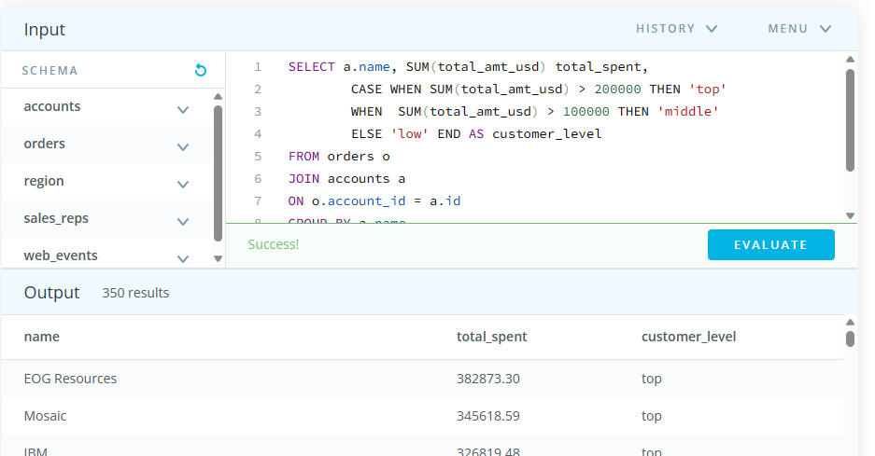
Objective : We would like to understand 3 different levels of customers based on the amount associated with their purchases. The top level includes anyone with a Lifetime Value (total sales of all orders) greater than 200,000 usd. The second level is between 200,000 and 100,000 usd. The lowest level is anyone under 100,000 usd. Provide a table that includes the level associated with each account. You should provide the account name, the total sales of all orders for the customer, and the level. Order with the top spending customers listed first.

Slide 29
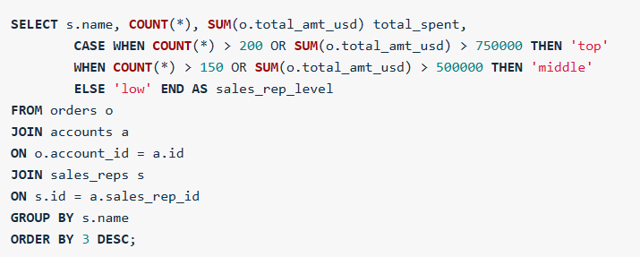
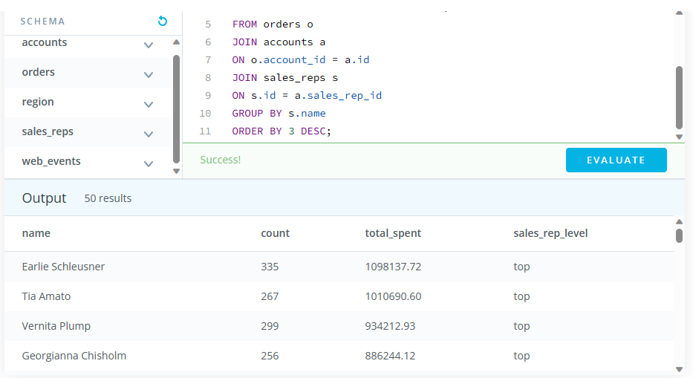
Objective: We would like to identify top performing sales reps, which are sales reps associated with more than 200 orders or more than 750000 in total sales. The middle group has any rep with more than 150 orders or 500000 in sales. Create a table with the sales rep name, the total number of orders, total sales across all orders, and a column with top, middle, or low depending on this criteria. Place the top sales people based on dollar amount of sales first in your final table.
--Here’s the full query

Slide 30
SQL SUBQUERIES
This section shows me using nested inner subqueries to be able to perform analysis on aggregated variables. This uses tables referenced in the most recent ERD shown.

Slide 31
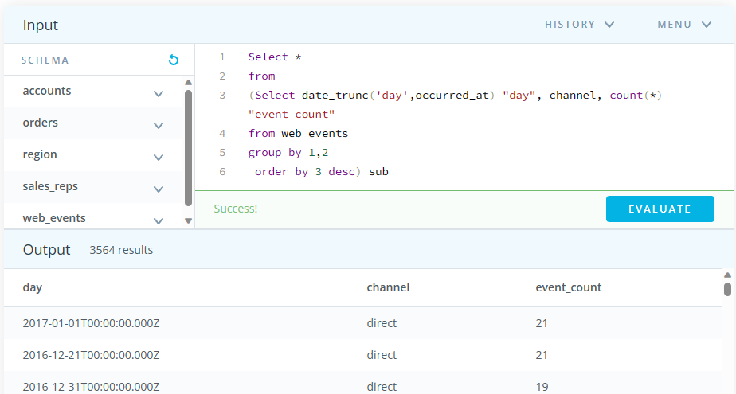
Objective: Identify which day-channel pair on which the most events occurred.

Slide 32
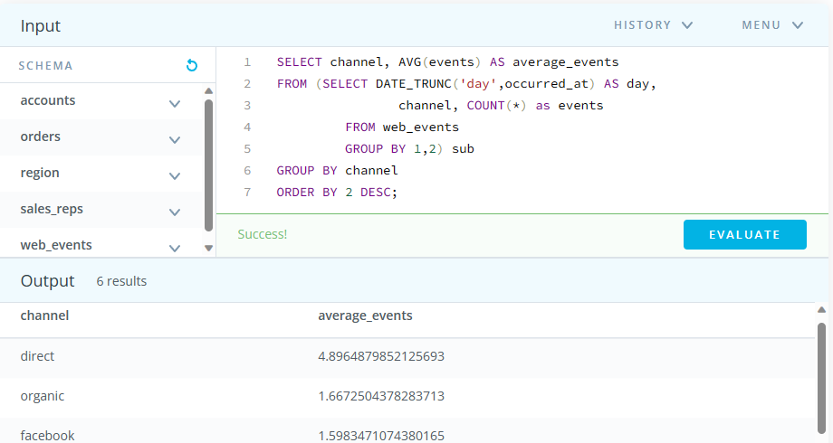
Objective: Find the average number of events per day per channel.

